Slide 1
Kaggle in-class Contest: Nexperia Image Classification II
DING, Weizhen 12229218
WANG, Kai 20738081

Slide 2
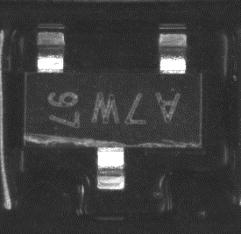
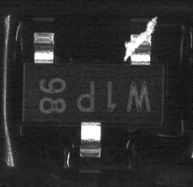
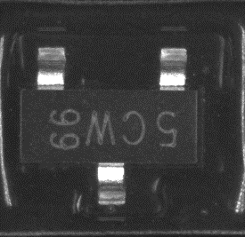
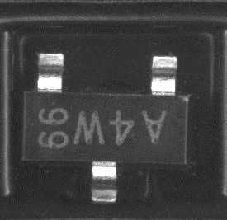
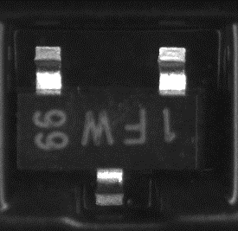
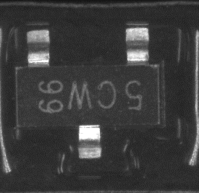
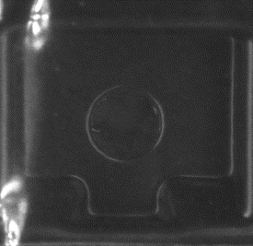
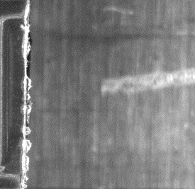
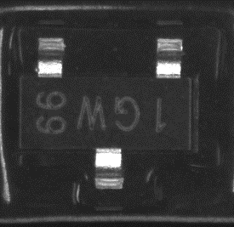
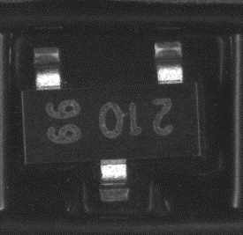
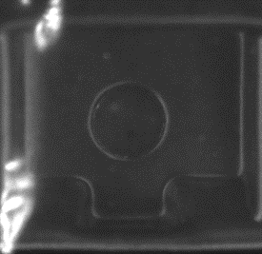
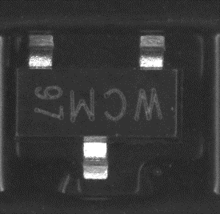
Dataset
defect
(6696/7039)
good
(27420)
train
(34459)
test
(3830)
Ref: https://www.kaggle.com/c/semi-conductor-image-classification-second-stage/overview

Slide 3
Data Augment
(Resampling)
defect
(6696)
defect
(6696)
good
(27420)
defect
(6696)
defect
(6696)

Slide 4
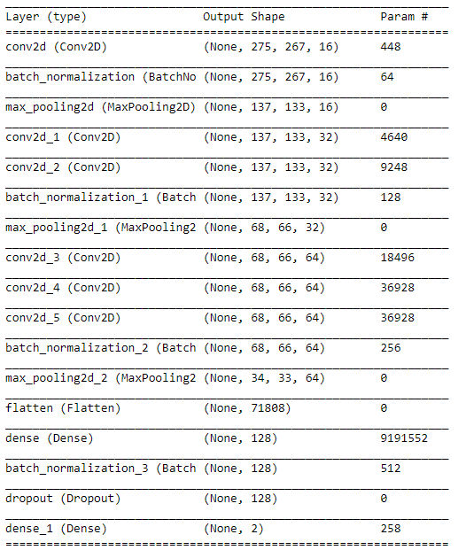
Model
Input
Conv 1-1
Pooling
Conv 2-1
Conv 2-2
Pooling
Conv 3-1
Conv 3-2
Conv 3-3
Pooling
Dense
Dense
Output
Total params: 9,299,458
Trainable params: 9,298,978
Non-trainable params: 480
Notes:
visualization

Slide 5
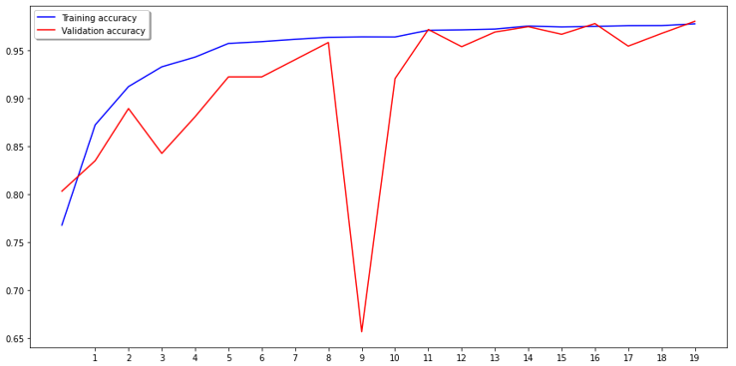
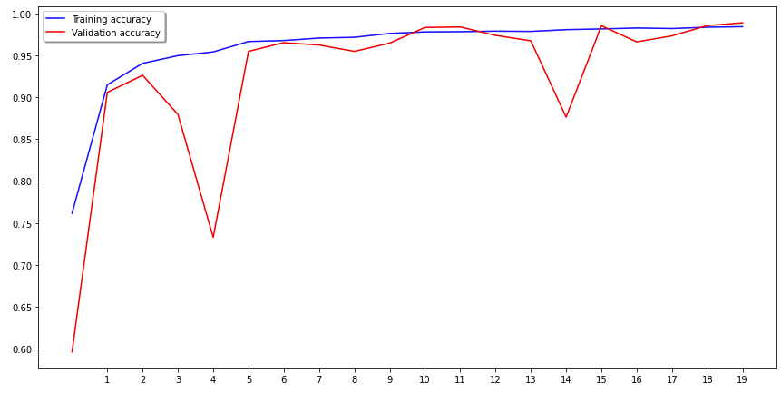
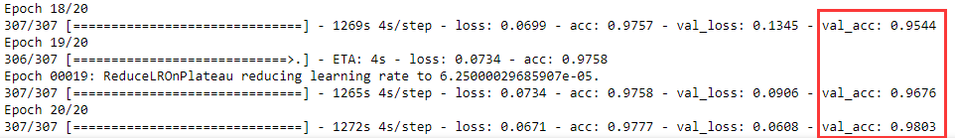
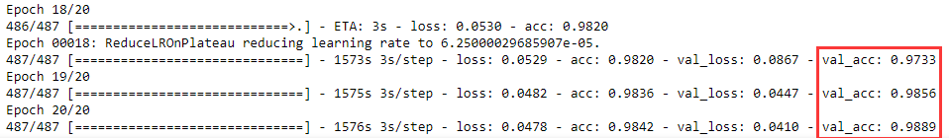
Train
Without resampling
With resampling
No. of epochs
No. of epochs

Slide 6




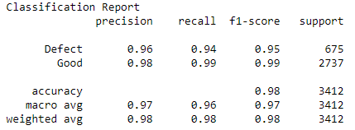
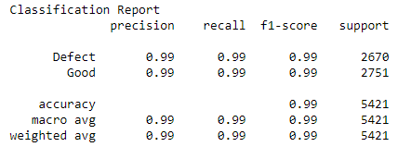
Validation
Without resampling
With resampling
Ground
Truth
Ground
Truth
Ground
Truth
Ground
Truth
Prediction
Prediction
Prediction
Prediction

Slide 7
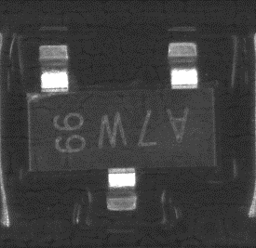
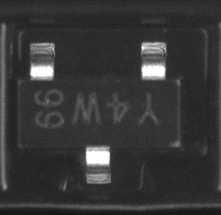
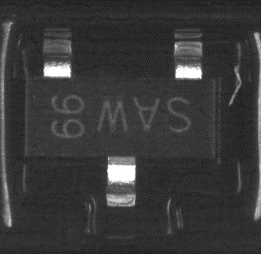
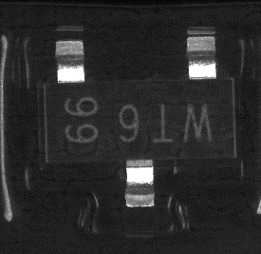
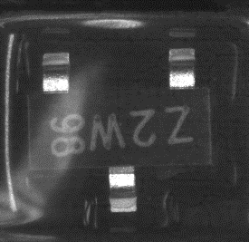
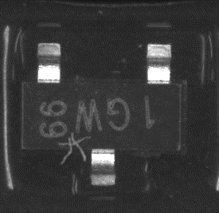
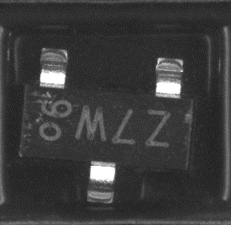
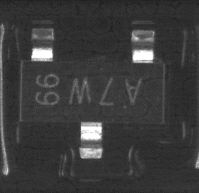
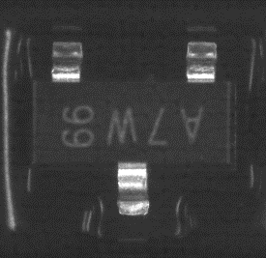
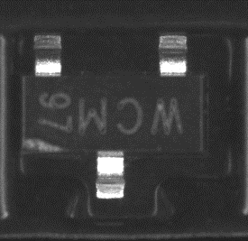
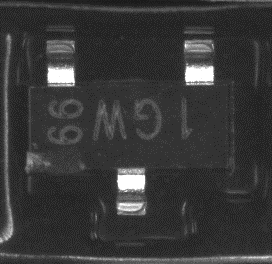
Validation – false negative
Ground
Truth
Ground
Truth
Prediction
Prediction
flawed image
(1/36)
possible failed prediction
(5/36)
possible incorrect label
(30/36)

Slide 8
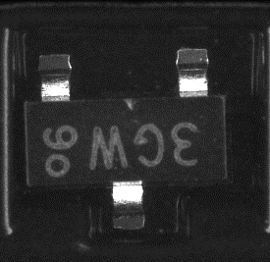
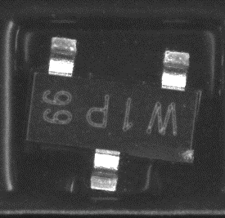
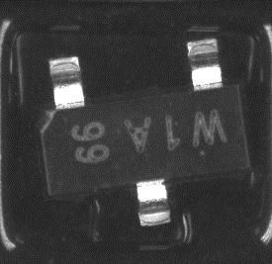
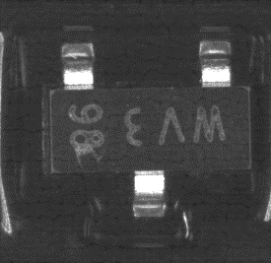
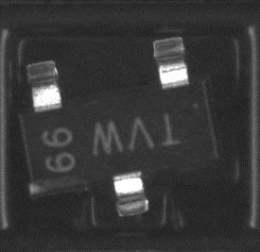
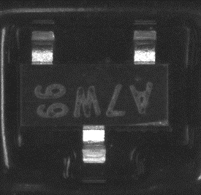
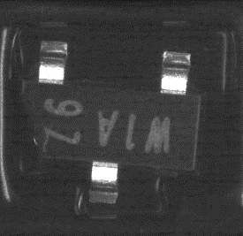
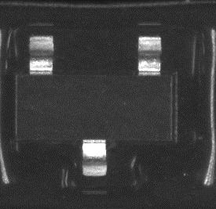
Validation – false positive
Ground
Truth
Ground
Truth
Prediction
Prediction
possible failed prediction
(25/25)

Slide 9
Comparison of the proposed model and other models
 | Proposed model | VGG16 | VGG19 | ResNet 50 | DenseNet 121 | DenseNet 169 | DenseNet 201
Params | 9MB | 132MB | 137MB | 24MB | 8MB | 14MB | 19MB
Depths | 11 | 23 | 26 | 50 | 121 | 169 | 201

Slide 10
Contribution and future work
We designed an effective light CNN network for the task.
We proposed several methods to improve the performance of the network by investigating the data.

Slide 11
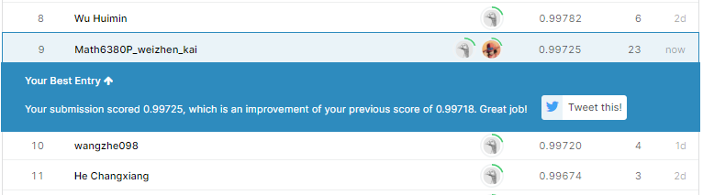
Test
Ref: https://www.kaggle.com/c/semi-conductor-image-classification-second-stage/leaderboard

Slide 12
Thank you.

